Slide 1

Quantifying Uncertainty
Introduction to Bayesian Inference
and Its Application
林成鍇 Julius Ling @ 國立成功大學大數據與AI研究中心

Slide 2
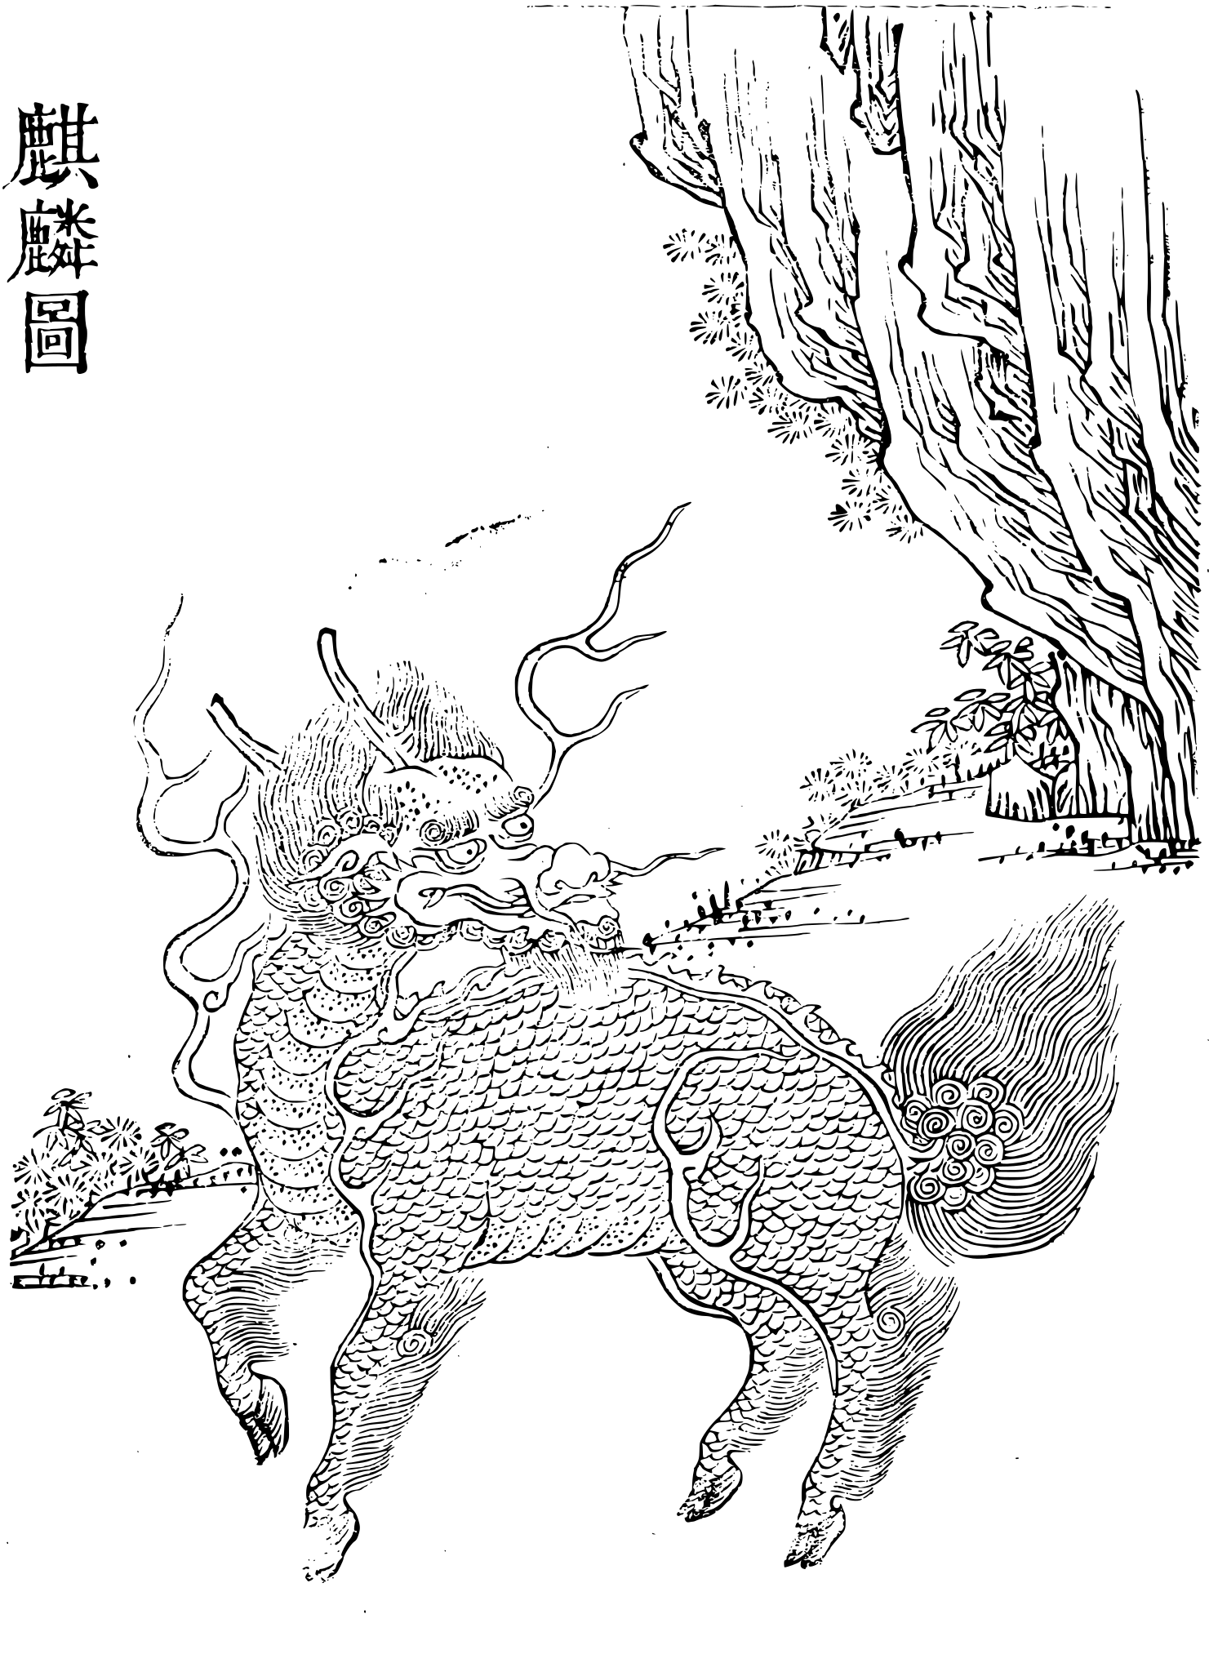
麟之爲靈，昭昭也。詠於《詩》，書於《春秋》，雜出於傳記百家之書，雖婦人小子皆知其爲祥也。然麟之爲物，不畜於家，不恆有於天下。其爲形也不類，非若馬牛犬豕豺狼麋鹿然。然則雖有麟，不可知其爲麟也。角者吾知其爲牛，鬣者吾知其爲馬，犬豕豺狼麋鹿，吾知其爲犬豕豺狼麋鹿。惟麟也，不可知。
-韓愈《獲麟解》

Slide 3
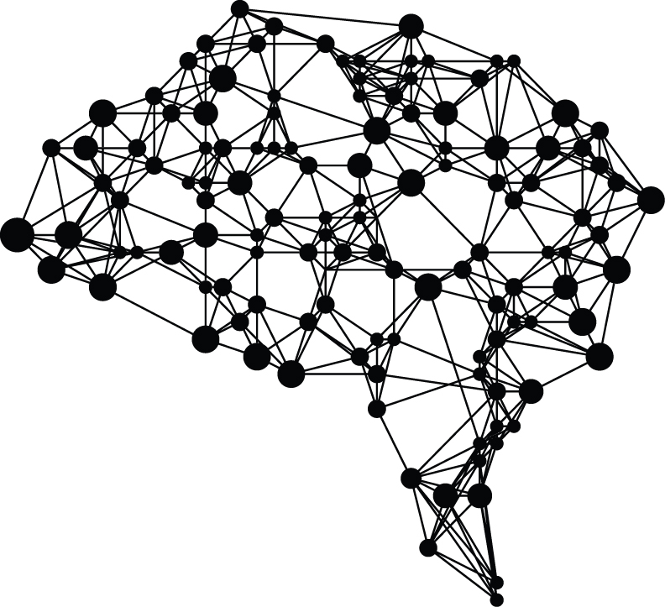
Outline
Why Bayesian?
How Bayesian?
Bayesian in Action

Slide 4
Outline
Why Bayesian?
How Bayesian?
Bayesian in Action

Slide 5
Why Bayesian?
Probability & Parameter
Probabilistic Terminologies
Frequentist V.S. Bayesian Inference

Slide 6
Why Bayesian?
Probability & Parameter
Probabilistic Terminologies
Frequentist V.S. Bayesian Inference

Slide 7
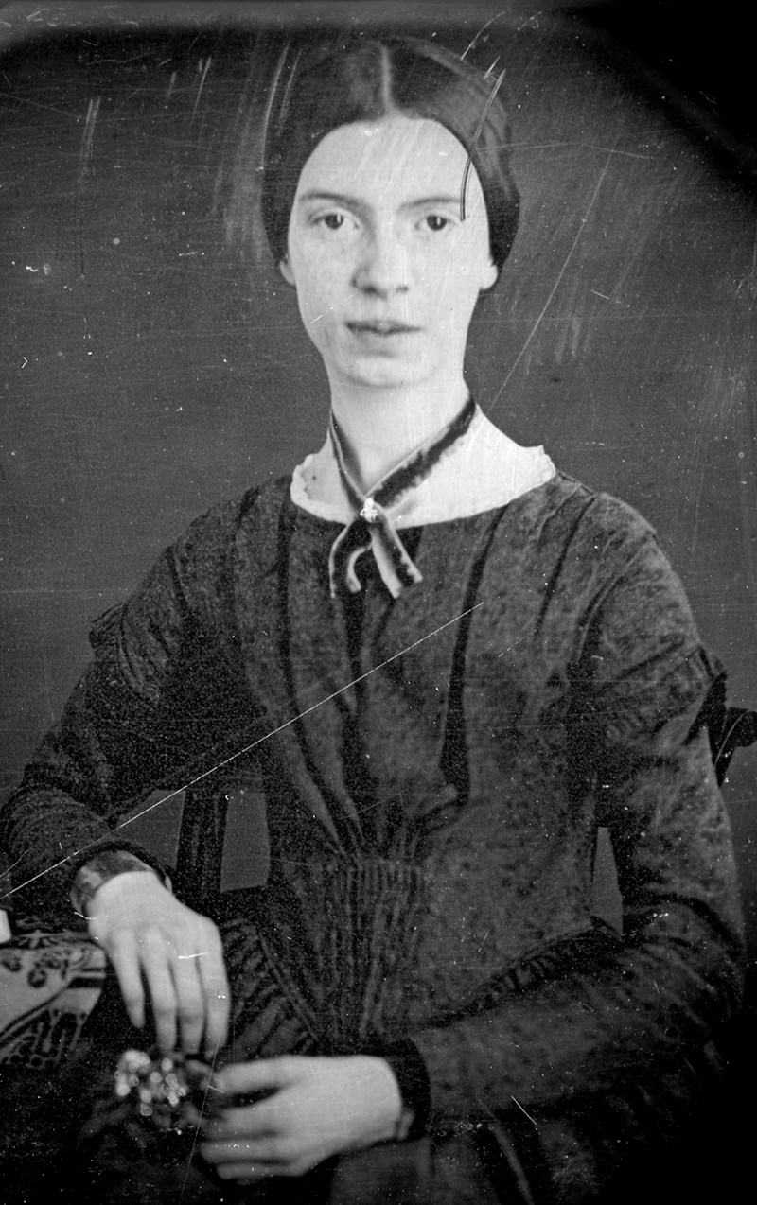
I dwell in Possibility –
A fairer House than Prose –
More numerous of Windows –
Superior – for Doors –
Of Chambers as the Cedars –
Impregnable of eye –
And for an everlasting Roof
The Gambrels of the Sky –
Of Visitors – the fairest –
For Occupation – This –
The spreading wide my narrow Hands
To gather Paradise –
I dwell in Possibility by Emily Dickinson
What is Probability?

Slide 8
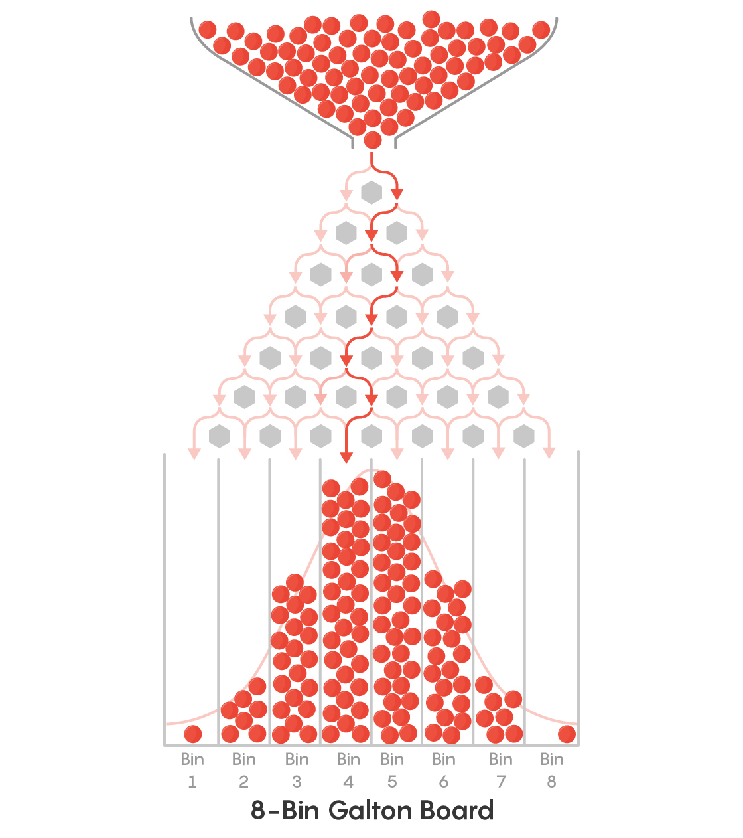
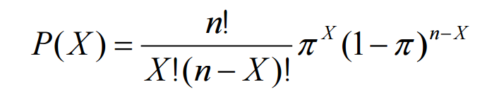
Probability As Description
(Classical Probability)

Slide 9

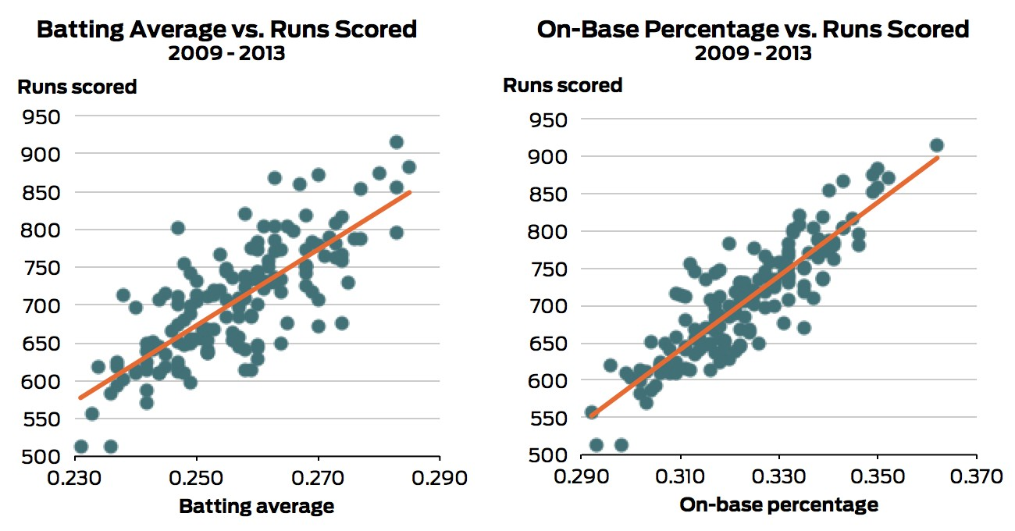
Probability As Description
(Empirical Probability)

Slide 10

Subjective Probability

Slide 11
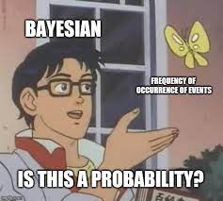


Frequentist Probability
V.S.
Bayesian Probability
Frequentist probability or frequentism defines an event's probability as the limit of its relative frequency in many trials. Probabilities can be found (in principle) by a repeatable objective process (and are thus ideally devoid of opinion).
Bayesian probability is an interpretation of the concept of probability, in which, instead of frequency or propensity of some phenomenon, probability is interpreted as reasonable expectation representing a state of knowledge or as quantification of a personal belief.

Slide 12
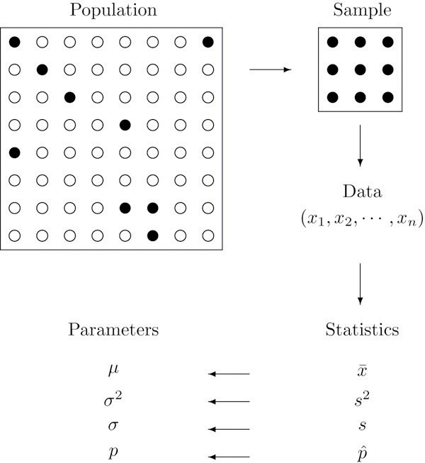
Frequentist Parameter

Slide 13
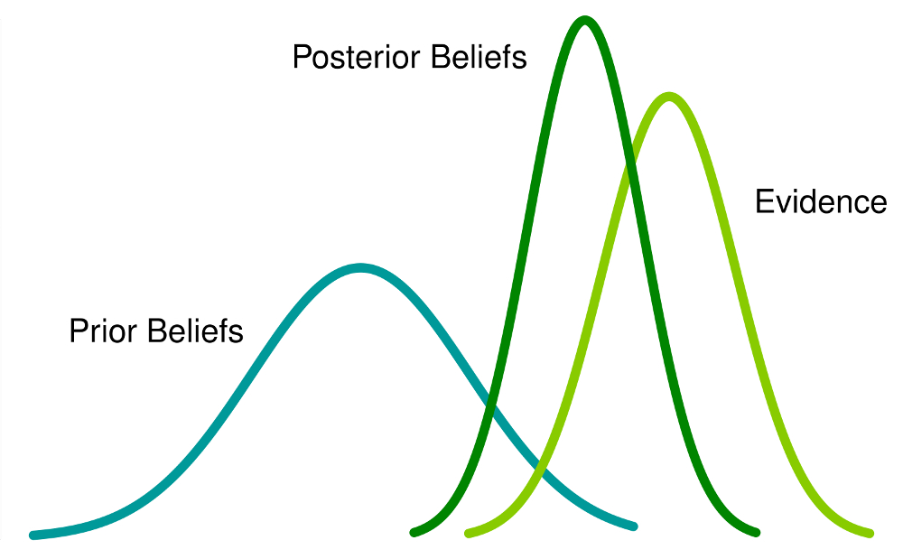
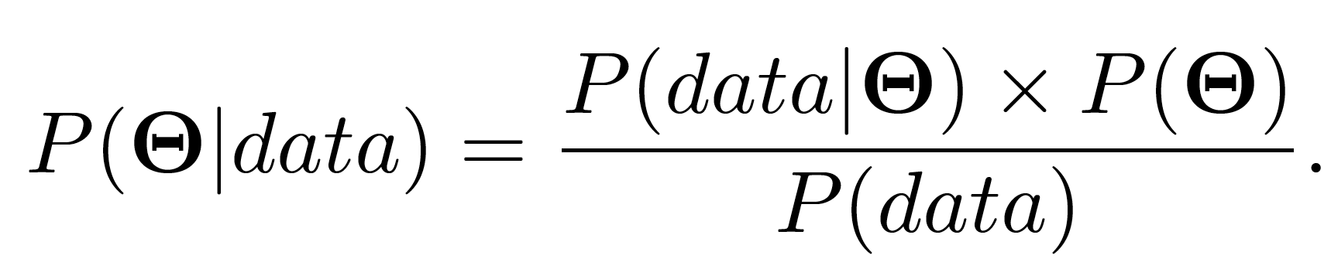
Bayesian Parameter

Slide 14
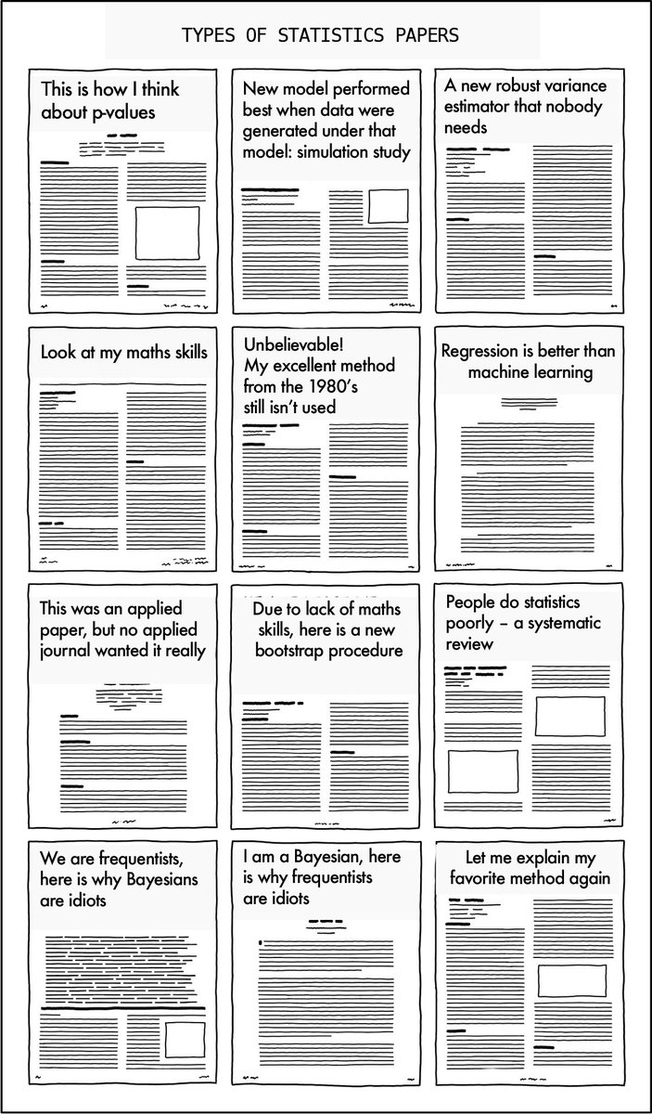

Slide 15
Why Bayesian?
Probability & Parameter
Probabilistic Terminologies
Frequentist V.S. Bayesian Inference

Slide 16
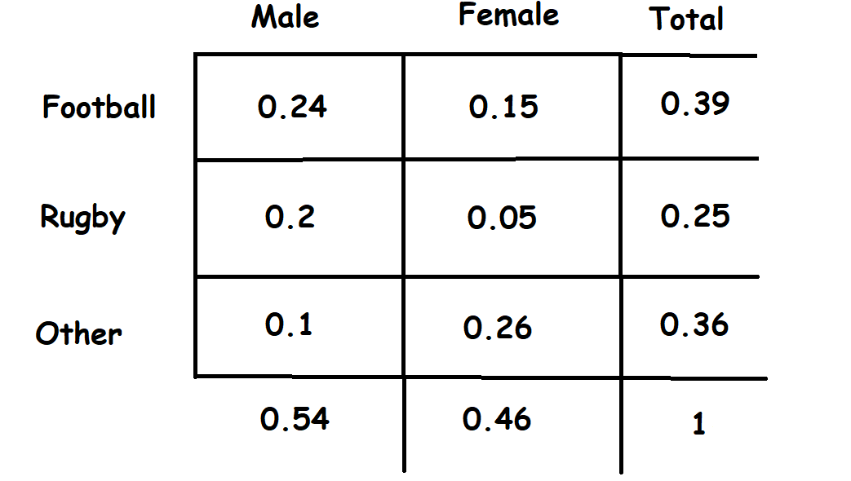
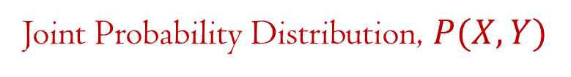
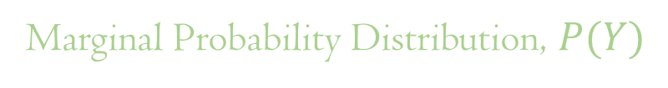
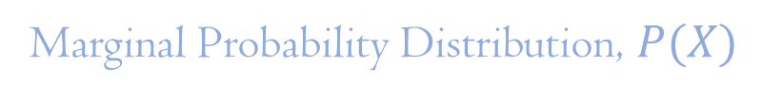
Probability Terminologies (Discrete)
Joint Probability Distribution, $P(X,Y)$
Marginal Probability Distribution, $P(X)$
Marginal Probability Distribution, $P(Y)$

Slide 17
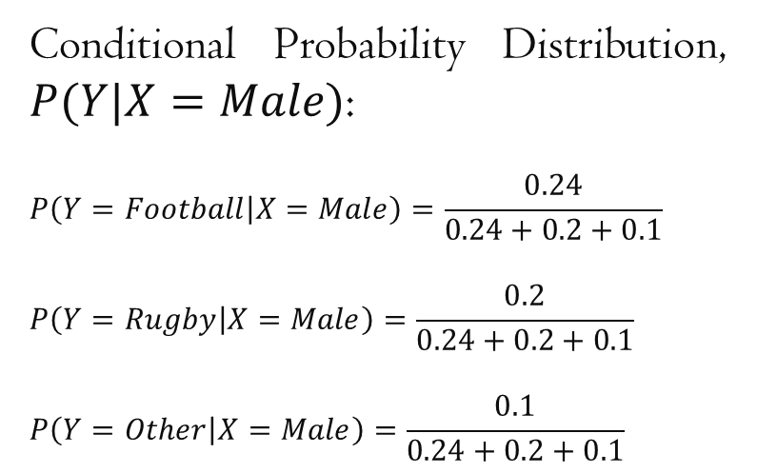
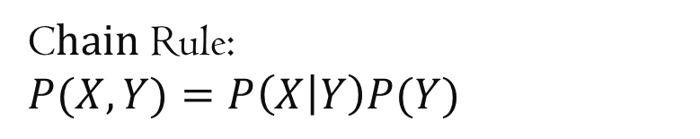
Probability Terminologies (Discrete)
Conditional Probability Distribution, $P(Y|X=Male)$:
$$P\left(Y=Football | X=Male\right)=\frac{0.24}{0.24+0.2+0.1}$$
$$P\left(Y=Rugby | X=Male\right)=\frac{0.2}{0.24+0.2+0.1}$$
$$P\left(Y=Other | X=Male\right)=\frac{0.1}{0.24+0.2+0.1}$$
C$hain$ Rule:
$$P(X,Y)=P\left(X | Y\right)P(Y)$$

Slide 18
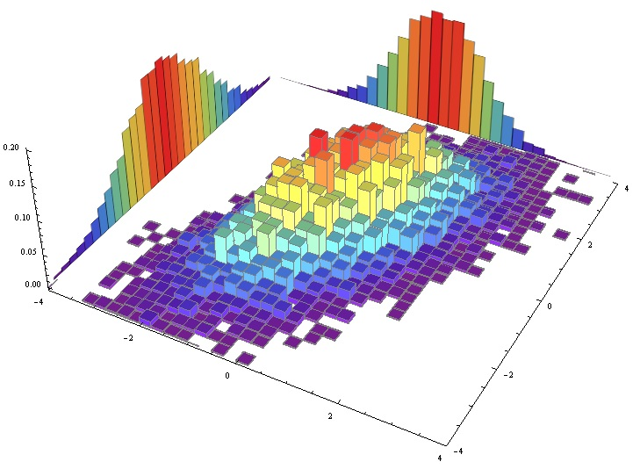
Multidimensional Distribution

Slide 19
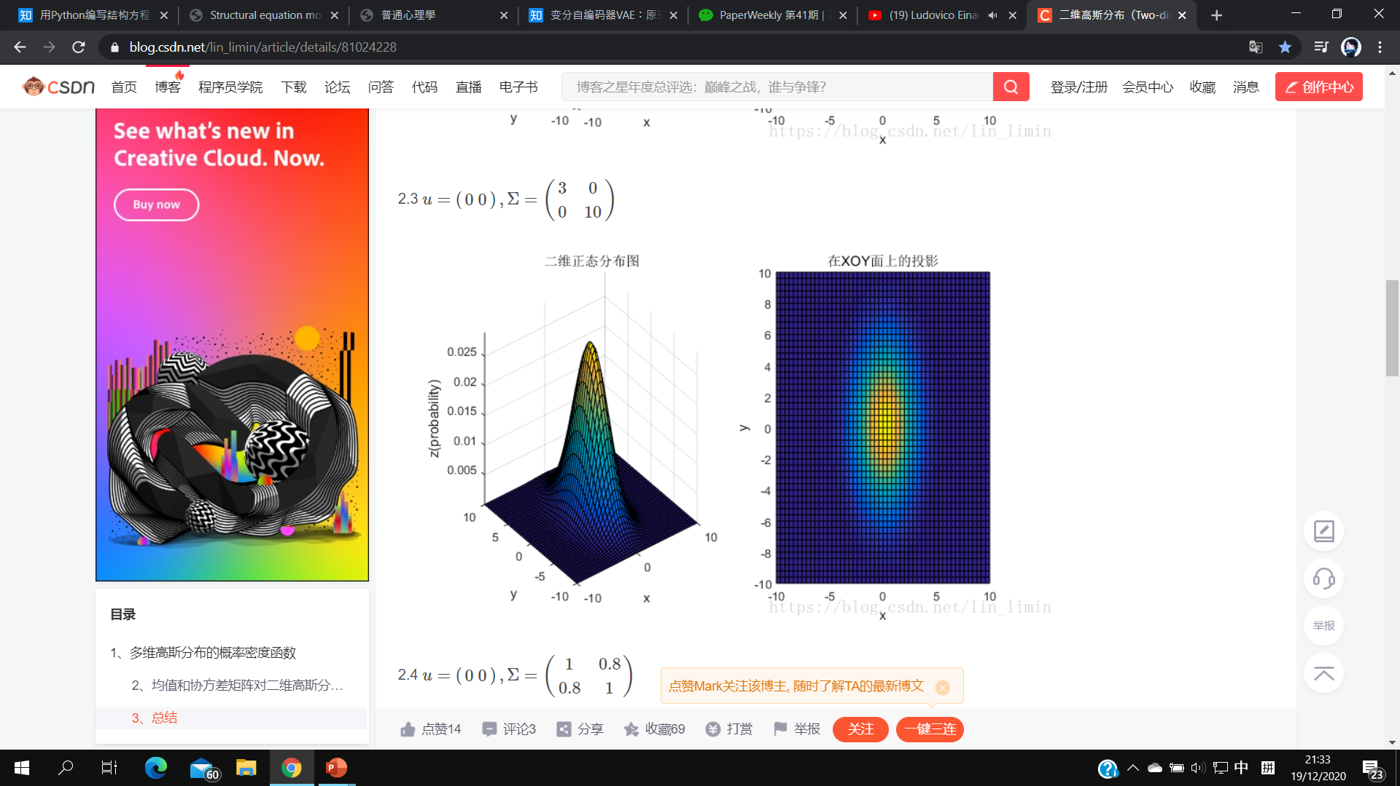
A Bivariate Gaussian Distribution

Slide 20
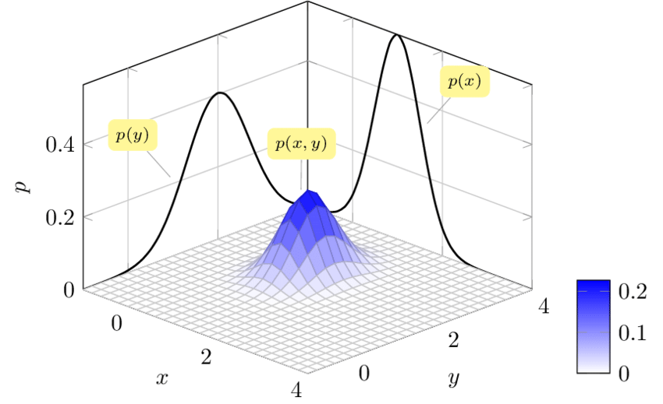
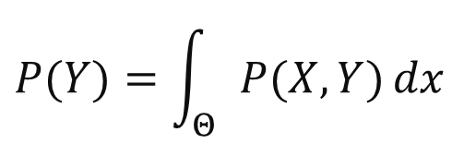
Probability Terminologies (Continuous)
$$P(Y)=\int_{Θ}{P(X,Y)}dx$$

Slide 21
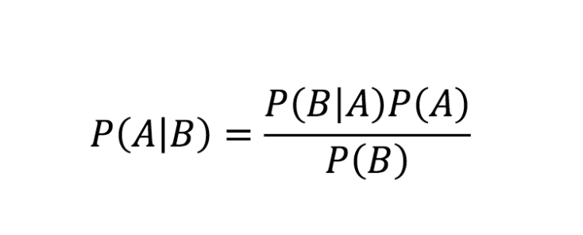
Bayes’ Theorem

Slide 22
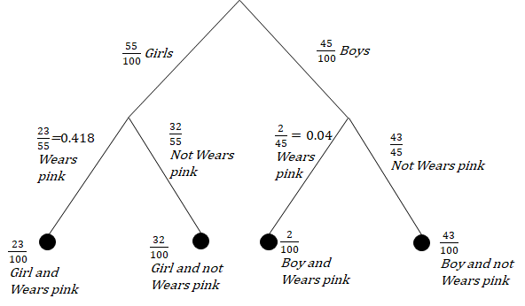
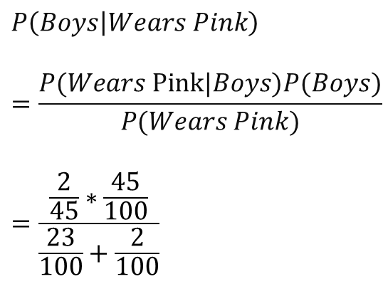
Bayes’ Theorem (Example)
$$P\left(Boys | Wears Pink\right)$$
$$=\frac{P(Wears Pink|Boys)P(Boys)}{P(Wears Pink)}$$
$$=\frac{\frac{2}{45}∗\frac{45}{100}}{\frac{23}{100}+\frac{2}{100}}$$

Slide 23
Bayes’ Theorem
Likelihood
Prior Probability
Posterior Probability
Marginal Probability
(Normalizing Factor)

Slide 24
Bayesian Statistics

Slide 25
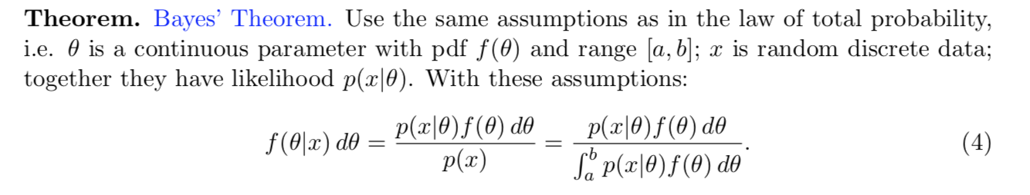
Bayes’ Theorem in Continuous Form
A scaling constant, which could be computationally intractable, if not impossible, given a high-dimensional probability distribution.

Slide 26
Why Bayesian?
Probability & Parameter
Probabilistic Terminologies
Frequentist V.S. Bayesian Inference

Slide 27
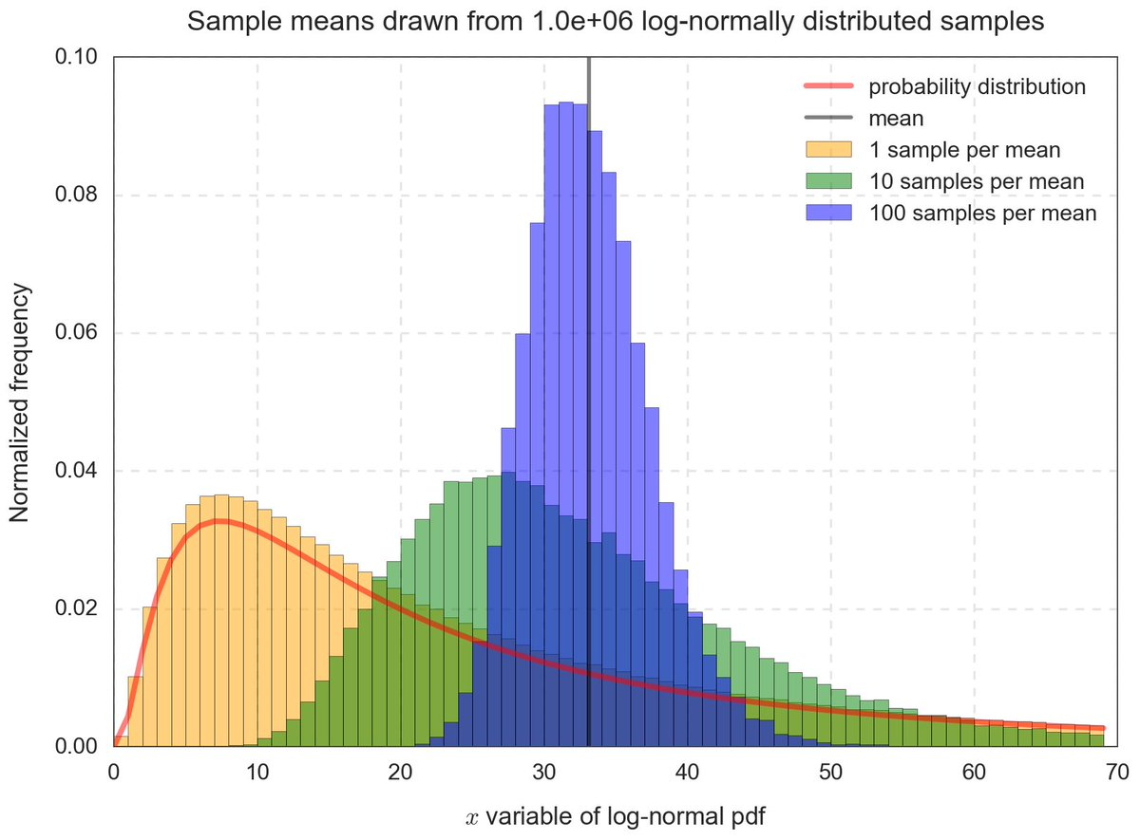
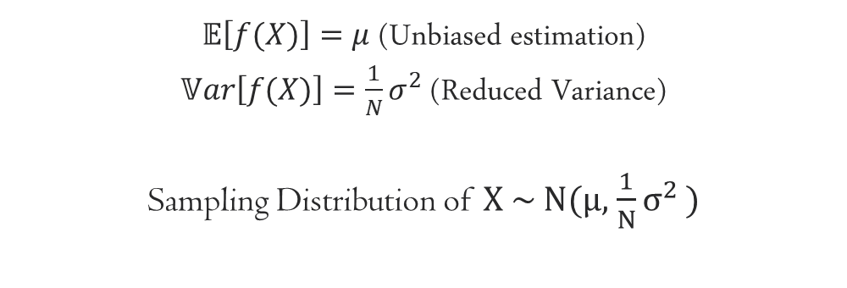
Central Limit Theorem
$𝔼\left[f(X)\right]=μ$ (Unbiased estimation)
$𝕍ar\left[f(X)\right]={\frac{1}{N}σ}^{2}$ (Reduced Variance)
Sampling Distribution of X ~ N($μ$, ${\frac{1}{N}σ}^{2}$ )

Slide 28
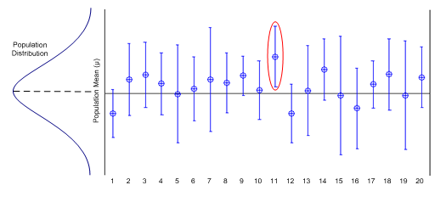
Frequentist Inference (Confidence Interval)

Slide 29
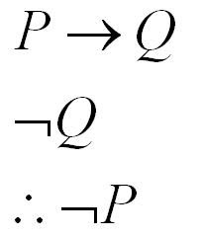
Modus Tollens & Hypothesis Testing

Slide 30
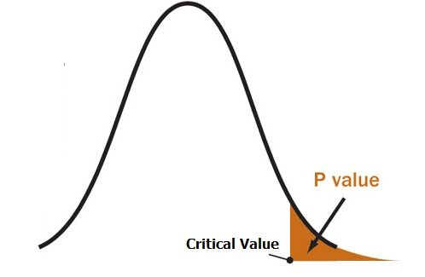
Frequentist Inference (p-value)

Slide 31
The (Mis)Interpretation of The p-Value
ASA Statement on Significance and p-Value
P-values can indicate how incompatible the data are with a specified statistical model.
P-values do not measure the probability that the studied hypothesis is true, or the probability that the data were produced by random chance alone.
Scientific conclusions and business or policy decisions should not be based only on whether a p-value passes a specific threshold.
Proper inference requires full reporting and transparency.
A p-value, or statistical significance, does not measure the size of an effect or the importance of a result.
By itself, a p-value does not provide a good measure of evidence regarding a model or hypothesis.
Moving to a World Beyond “p < 0.05”

Slide 32
Bayesian Inference
(Credible Interval & Multiple Hypothesis Testing)

Slide 33

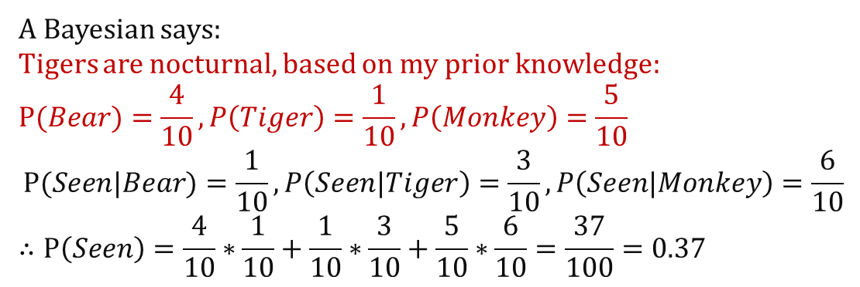
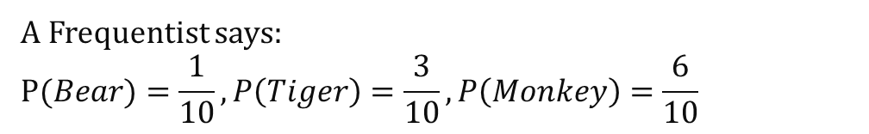
Frequentist V.S. Bayesian Inference (Example)
$$\#(Bear)=1, \#\left(Tiger\right)=3, \#\left(Monkey\right)=6$$
A Frequentist says:
$$P(Bear)=\frac{1}{10}, P\left(Tiger\right)=\frac{3}{10}, P\left(Monkey\right)=\frac{6}{10}$$
A Bayesian says:
Tigers are nocturnal, based on my prior knowledge:
$$P(Bear)=\frac{4}{10}, P\left(Tiger\right)=\frac{1}{10}, P\left(Monkey\right)=\frac{5}{10}$$
$$P(Seen|Bear)=\frac{1}{10}, P\left(Seen|Tiger\right)=\frac{3}{10}, P\left(Seen|Monkey\right)=\frac{6}{10}$$
$$∴P\left(Seen\right)=\frac{4}{10}∗\frac{1}{10}+\frac{1}{10}∗\frac{3}{10}+\frac{5}{10}∗\frac{6}{10}=\frac{37}{100}=0.37$$
$$∴P\left(Bear | Seen\right)=\frac{\frac{4}{10}∗\frac{1}{10}}{0.37}=0.1081, P\left(Tiger|Seen\right)=\frac{\frac{1}{10}∗\frac{3}{10}}{0.37},=0.081, P\left(Monkey|Seen\right)=\frac{\frac{5}{10}∗\frac{6}{10}}{0.37}=0.81$$

Slide 34
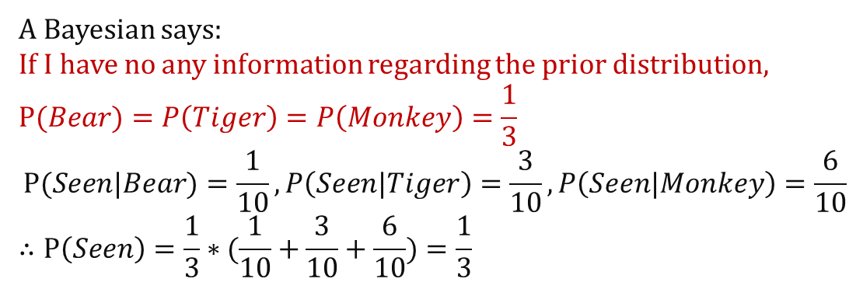
Frequentist V.S. Bayesian Inference (Example)
$$\#(Bear)=1, \#\left(Tiger\right)=3, \#\left(Monkey\right)=6$$
A Frequentist says:
$$P(Bear)=\frac{1}{10}, P\left(Tiger\right)=\frac{3}{10}, P\left(Monkey\right)=\frac{6}{10}$$
A Bayesian says:
If I have no any information regarding the prior distribution,
$$P(Bear)=P\left(Tiger\right)=P\left(Monkey\right)=\frac{1}{3}$$
$$P(Seen|Bear)=\frac{1}{10}, P\left(Seen|Tiger\right)=\frac{3}{10}, P\left(Seen|Monkey\right)=\frac{6}{10}$$
$$∴P\left(Seen\right)=\frac{1}{3}∗(\frac{1}{10}+\frac{3}{10}+\frac{6}{10})=\frac{1}{3}$$
$$∴P\left(Bear | Seen\right)=\frac{\frac{1}{3}∗\frac{1}{10}}{\frac{1}{3}}=\frac{1}{10}, P\left(Tiger|Seen\right)=\frac{\frac{1}{3}∗\frac{3}{10}}{\frac{1}{3}},=\frac{3}{10}, P\left(Monkey|Seen\right)=\frac{\frac{1}{3}∗\frac{6}{10}}{\frac{1}{3}}=\frac{6}{10}$$

Slide 35
Bayesian
Statistics
Frequentist
Statistics

Slide 36
Outline
Why Bayesian?
How Bayesian?
Bayesian in Action

Slide 37
How Bayesian?
Probabilistic Programming
Markov Chain
Monte Carlo Method
Generating Random Sample
Bayes’ Theorem Revisit
Markov Chain Monte Carlo (MCMC) Method

Slide 38
How Bayesian?
Probabilistic Programming
Markov Chain
Monte Carlo Method
Generating Random Sample
Bayes’ Theorem Revisit
Markov Chain Monte Carlo (MCMC) Method

Slide 39

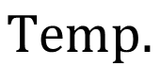
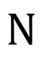
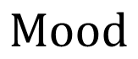
Plate Notation
$$Temp.$$
$$Mood$$
$$N$$

Slide 40
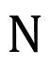
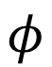
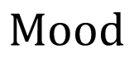
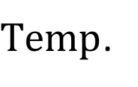
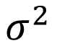
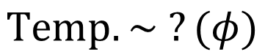
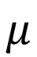
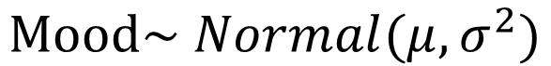
Plate Notation (Frequentist Inference)
$$Mood\sim Normal(μ,σ^{2})$$
$$φ$$
$Temp$.
$$Mood$$
$$N$$
$$Temp.\sim ?(φ)$$
$$μ$$
$$σ^{2}$$

Slide 41
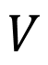
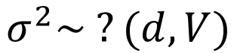
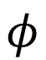
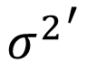
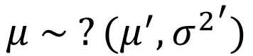
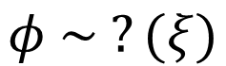





Plate Notation (Bayesian Inference)
$$Mood\sim Normal(μ,σ^{2})$$
$$ξ$$
$$φ$$
$Temp$.
$$Mood$$
$$Temp.\sim ?(φ)$$
$$N$$
$$σ^{2}\sim ?(d,V)$$
$$φ \sim ?(ξ)$$
$$μ^{′}$$
$$d$$
$$μ$$
$$σ^{2}$$
$$μ \sim ?(μ^{′},{σ^{2}}^{′})$$
$${σ^{2}}^{′}$$
$$V$$

Slide 42

Conjugate Prior
共軛先驗
In Bayesian probability theory, if the posterior distribution P(θ|x) is in the same probability distribution family as the prior probability distribution P(θ), the prior and posterior are then called conjugate distributions, and the prior is called a conjugate prior for the likelihood function P(x|θ).
Conjugate Prior

Slide 43

Conjugate Distribution
共軛分佈
.
.
.
It’s an Art to opt for appropriate distribution in your model. It requires rich statistical and domain knowledge.
Conjugate Prior

Slide 44
How Bayesian?
Probabilistic Programming
Markov Chain
Monte Carlo Method
Generating Random Sample
Bayes’ Theorem Revisit
Markov Chain Monte Carlo (MCMC) Method

Slide 45


Markov Process and Markov Chain
(Discrete State)
Markov property:
$$P\left(future | present,past\right)=P(future|present)$$
Markov chain (for example):
r c c c r s s r s r r c r c c c s ……

Slide 46


The Ergodicity (遍歷性)of A Markov Chain
Markov chain (for example):
r c c c ……
$$P\left(Markov Chain\right)$$
$=P\left(x_{1}=r\right)P(x_{2}=c|x_{1}=r)$ $P\left(x_{2}=c | x_{1}=c\right)P\left(x_{3}=c | x_{2}=c\right)……$
$$=P\left(x_{1}=r\right)∗0.1∗0.3∗0.3……$$
Initial Probability Distribution
Transitional Probability Kernel
A probability distribution π satisfies ergodicity if it verifies:
$π=πp=πp^{2}=…$, π is a stationary distribution.

Slide 47

The Ergodicity of A Markov Chain
(Example)
如果台北每年有20%的人遷出外縣市，
每年有10%的外縣市人口遷入台北市，
假設總人口數一直不變，請問長期而言台北市與外縣市的人口比例會是如何 ?
針對這個問題，我們可以簡單列出一個公式， 令 s 代表外縣市人口數，t 代表台北市人口數，k 為年份，則可以有如下的方程解 :
$$s_{k+1}=0.9s_{k}+0.2t_{k}$$
$$t_{k+1}=0.1s_{k}+0.8t_{k}$$
以矩陣表示：
$$\left[\begin{matrix}s_{k+1} \\ t_{k+1}\end{matrix}\right]=\left[\begin{matrix}0.9 & 0.2 \\ 0.1 & 0.8\end{matrix}\right]\left[\begin{matrix}s_{k} \\ t_{k}\end{matrix}\right]$$
長期來看：
$$\left[\begin{matrix}s_{k+1} \\ t_{k+1}\end{matrix}\right]=\left[\begin{matrix}s_{k} \\ t_{k}\end{matrix}\right]=\left[\begin{matrix}s \\ t\end{matrix}\right]$$
https://ccjou.wordpress.com/2009/08/06/%E9%A6%AC%E5%8F%AF%E5%A4%AB%E9%81%8E%E7%A8%8B/

Slide 48

The Ergodicity of A Markov Chain
(Example)
$$\left[\begin{matrix}s \\ t\end{matrix}\right]=\left[\begin{matrix}0.9 & 0.2 \\ 0.1 & 0.8\end{matrix}\right]\left[\begin{matrix}s \\ t\end{matrix}\right]$$
這是一個x=px形式,求解p的特徵值（eigenvalue）及特徵向量（eigenvector）的問題。
$$Det\left(\left[\begin{matrix}0.9−λ & 0.2 \\ 0.1 & 0.8−λ\end{matrix}\right]\right)=\left(0.9−λ\right)\left(0.8−λ\right)−0.2∗0.1=0$$
$$λ_{1}=1, λ_{2}=0.7$$
$λ_{2}=0.7$不合題意（求出的eigenvector會有負值），
$λ_{1}=1$，
$$\left(P−λI\right)\vec{v}=0$$
$$\left[\begin{matrix}−0.1 & 0.2 \\ 0.1 & −0.2\end{matrix}\right]\vec{v}=0$$
以高斯消元法求解$\vec{v}$，
$$s:t=2:1$$

Slide 49

The Reversibility of A Markov Chain
Inflow
Outflow
Stock
A reversed Markov Chain:
$$P(r c c c ……) =P(…… c c c r)$$
Whenever the steady state is reached, the equilibrium below holds:
$$π\left(x_{n}\right)P\left(x_{n+1}|x_{n}\right)=π\left(x_{n+1}\right)P\left(x_{n}|x_{n+1}\right)$$
This equation is called Detailed Balance 細緻平衡.

Slide 50

The Reversibility of A Markov Chain
Inflow
Outflow
Stock
$$π\left(x_{n}\right)P\left(x_{n+1}|x_{n}\right)=π\left(x_{n+1}\right)P\left(x_{n}|x_{n+1}\right)$$
$$\sum_{x_{n+1}}{π\left(x_{n}\right)P\left(x_{n+1}|x_{n}\right)}=\sum_{x_{n+1}}{π\left(x_{n+1}\right)P(x_{n}|x_{n+1)}}$$
$$π\left(x_{n}\right)=\sum_{x_{n+1}}{π\left(x_{n+1}\right)P\left(x_{n}|x_{n+1}\right)}$$
This equation serves as an indicator of the convergence of
a Markov Chain towards a stationary distribution.

Slide 51
How Bayesian?
Probabilistic Programming
Markov Chain
Monte Carlo Method
Generating Random Sample
Bayes’ Theorem Revisit
Markov Chain Monte Carlo (MCMC) Method

Slide 52

Monte Carlo Approximation

Slide 53


Monte Carlo Approximation (Integration)
$$\int_{a}^{b}{f\left(x\right)dx≈\frac{1}{N}\sum_{i}^{N}{\frac{f(x_{i})}{p.d.f(x_{i})}}},$$
$$typically the p.d.f used is a uniform distribution function$$

Slide 54
How Bayesian?
Probabilistic Programming
Markov Chain
Monte Carlo Method
Generating Random Sample
Bayes’ Theorem Revisit
Markov Chain Monte Carlo (MCMC) Method

Slide 55

Cumulative Distribution Function (CDF)

Slide 56

Inverse Transform Sampling
(a.k.a Smirnov transform)
Inverse Transform Sampling, which is a basic method for pseudo-random number sampling (i.e., generating samples at random from any probability distribution given its Cumulative Distribution Function)
This is the very core idea of the architect of the Generative Adversarial Networks (GAN).

Slide 57

Inverse Transform Sampling
(a.k.a Smirnov transform)
If $X$ is a continuous random variable with cumulative distribution function $F_{x}$, then the random variable $Y=F_{X}(X)$has a uniform distribution on [0, 1]. The inverse probability integral transform is just the inverse of this: specifically, the random variable $F_{X}^{−1}\left(Y\right)$ has the same distribution as $X$.
However, this technique is hardly applicable on complex, high-dimensional probability distributions, which the CDF is unknown.

Slide 58


Accept-Reject Sampling 接受-拒絕抽樣
The prerequisite of the proposal distribution must be fulfilled (the domain of the proposal’s includes the target’s). This is the core concept of the MCMC method.

Slide 59


Cholesky Decomposition
$$A=LL^{T}$$
Symmetric Matrix

Slide 60

Cholesky Decomposition (Example)
$$\left[\begin{matrix}36 & 30 & 18 \\ 30 & 41 & 23 \\ 18 & 23 & 14\end{matrix}\right]=\left[\begin{matrix}6 & 0 & 0 \\ 5 & 4 & 0 \\ 3 & 2 & 1\end{matrix}\right]\left[\begin{matrix}6 & 5 & 3 \\ 0 & 4 & 2 \\ 0 & 0 & 1\end{matrix}\right]$$
$$A=LL^{T}$$
Symmetric Matrix

Slide 61


Multivariate Distribution as
The Extension of The Univariate Distribution
We can see that the marginal distribution of a Multivariate Gaussian Distribution is still “Gaussian”.

Slide 62


Multivariate Sampling 多元分佈抽樣
Covariance Matrix
Cholesky Decomposition
Why?
Given the uncorrelated random variable, $Z\sim N\left(0,1\right),𝔼\left(ZZ^{T}\right)=I$
$$𝔼\left(XX^{T}\right)= 𝔼\left(\left(ZQ\right){\left(ZQ\right)}^{T}\right)=𝔼\left(ZQQ^{T}Z^{T}\right)$$
$$=QE\left(ZZ^{T}\right)Q^{T}=QIQ^{T}=Q^{T}Q=Σ$$

Slide 63




Slide 64
How Bayesian?
Probabilistic Programming
Markov Chain
Monte Carlo Method
Generating Random Sample
Bayes’ Theorem Revisit
Markov Chain Monte Carlo (MCMC) Method

Slide 65
Bayes’ Theorem
Likelihood
Prior Probability
Posterior Probability
Marginal Probability
(Normalizing Factor)

Slide 66
Bayes’ Theorem in Continuous Form
So instead, we try to sample from the posterior distribution and compute the statistics (mean, variance etc.) from the MCMC samples.
A scaling constant, which could be computationally intractable, if not impossible, given a high-dimensional probability distribution.

Slide 67
How Bayesian?
Probabilistic Programming
Markov Chain
Monte Carlo Method
Generating Random Sample
Bayes’ Theorem Revisit
Markov Chain Monte Carlo (MCMC) Method

Slide 68

Bayesian Modelling is like making dishes.

Slide 69





The Recipe
This defines the posterior distribution.
$$Mood\sim Normal(μ,σ^{2})$$
$$ξ$$
$$φ$$
$Temp$.
$$Mood$$
$$Temp.\sim ?(φ)$$
$$N$$
$$σ^{2}\sim ?(d,V)$$
$$φ \sim ?(ξ)$$
$$μ^{′}$$
$$d$$
$$μ$$
$$σ^{2}$$
$$μ \sim ?(μ^{′},{σ^{2}}^{′})$$
$${σ^{2}}^{′}$$
$$V$$

Slide 70






The Ingredients
You rely on your data to estimate the parameters.
$$Mood\sim Normal(μ,σ^{2})$$
$$ξ$$
$$φ$$
$Temp$.
$$Mood$$
$$Temp.\sim ?(φ)$$
$$N$$
$$σ^{2}\sim ?(d,V)$$
$$φ \sim ?(ξ)$$
$$μ^{′}$$
$$d$$
$$μ$$
$$σ^{2}$$
$$μ \sim ?(μ^{′},{σ^{2}}^{′})$$
$${σ^{2}}^{′}$$
$$V$$

Slide 71








How Much Salt Added?
(The hyperparameters indicates your “taste & preference”.)
$$Mood\sim Normal(μ,σ^{2})$$
$$ξ$$
$$φ$$
$Temp$.
$$Mood$$
$$Temp.\sim ?(φ)$$
$$N$$
$$σ^{2}\sim ?(d,V)$$
$$φ \sim ?(ξ)$$
$$μ^{′}$$
$$d$$
$$μ$$
$$σ^{2}$$
$$μ \sim ?(μ^{′},{σ^{2}}^{′})$$
$${σ^{2}}^{′}$$
$$V$$

Slide 72
Start Cooking
Ready to go (draw samples), but how?
$$Mood\sim Normal(μ,σ^{2})$$
$$ξ$$
$$φ$$
$Temp$.
$$Mood$$
$$Temp.\sim ?(φ)$$
$$N$$
$$σ^{2}\sim ?(d,V)$$
$$φ \sim ?(ξ)$$
$$μ^{′}$$
$$d$$
$$μ$$
$$σ^{2}$$
$$μ \sim ?(μ^{′},{σ^{2}}^{′})$$
$${σ^{2}}^{′}$$
$$V$$

Slide 73

Recall: The Detailed Balance
Inflow
Outflow
Stock
Whenever the steady state is reached, the equilibrium below holds:
$$π\left(x_{n}\right)P\left(x_{n}|x_{n+1}\right)=π\left(x_{n+1}\right)P\left(x_{n+1}|x_{n}\right)$$
$$π\left(x_{n}\right)=\sum_{x_{n+1}}{π\left(x_{n+1}\right)P\left(x_{n+1}|x_{n}\right)}$$

Slide 74
Recall: Accept-Reject Sampling 接受-拒絕抽樣
The prerequisite of the proposal distribution must be fulfilled (the domain of the proposal’s includes the target’s). This is the core concept of the MCMC method.

Slide 75
To draw samples from the Posterior Distribution, we’re constructing a Markov Process to obtain a Markov Chain of the stationary targeted posterior distribution.
We’re introducing apart from the very basic MCMC algorithm and also Metropolis-Hastings Transition & Gibbs Sampling 吉布斯采樣 algorithms.

Slide 76

Recall: The Transition Matrix 轉移矩陣
如果台北每年有20%的人遷出外縣市，
每年有10%的外縣市人口遷入台北市，
假設總人口數一直不變，請問長期而言台北市與外縣市的人口比例會是如何 ?
針對這個問題，我們可以簡單列出一個公式， 令 s 代表外縣市人口數，t 代表台北市人口數，k 為年份，則可以有如下的方程解 :
$$s_{k+1}=0.9s_{k}+0.2t_{k}$$
$$t_{k+1}=0.1s_{k}+0.8t_{k}$$
以矩陣表示：
$$\left[\begin{matrix}s_{k+1} \\ t_{k+1}\end{matrix}\right]=\left[\begin{matrix}0.9 & 0.2 \\ 0.1 & 0.8\end{matrix}\right]\left[\begin{matrix}s_{k} \\ t_{k}\end{matrix}\right]$$
長期來看：
$$\left[\begin{matrix}s_{k+1} \\ t_{k+1}\end{matrix}\right]=\left[\begin{matrix}s_{k} \\ t_{k}\end{matrix}\right]=\left[\begin{matrix}s \\ t\end{matrix}\right]$$
https://ccjou.wordpress.com/2009/08/06/%E9%A6%AC%E5%8F%AF%E5%A4%AB%E9%81%8E%E7%A8%8B/

Slide 77

Markov Chain Monte Carlo
Initiate a symmetric transition matrix P randomly. The targeted distribution (the posterior distribution) is defined. Based on the current state i, P suggests a candidate transition.
(if $P\left(x_{n+1}=j|x_{n}=i\right)$> $P\left(x_{n+1}=i|x_{n}=i\right)$, P suggests a switch
from i to j).
2. A sample u is drawn from a Uniform Distribution. If:
$u<Q=π\left(x_{n+1}\right)P\left(x_{n}|x_{n+1}\right)$, then it switches from the current state i
to j, otherwise it remains at i.
3. The process is repeated N times.
Why TF is that?!

Slide 78


Acceptance Rate 接受率 (Q)
Whenever the steady state is reached, the equilibrium below holds:
$$π\left(x_{n}\right)P\left(x_{n+1}|x_{n}\right)=π\left(x_{n+1}\right)P\left(x_{n}|x_{n+1}\right)$$
$$P\left(x_{n}|x_{n+1}\right)=P\left(x_{n+1}|x_{n}\right) ∵P is a symmetric matrix$$
At the beginning of the Markov Process, it’s probably that:
$$π\left(x_{n}\right)P\left(x_{n+1}|x_{n}\right)≠π\left(x_{n+1}\right)P\left(x_{n}|x_{n+1}\right)$$
$$π\left(x_{n}\right)P\left(x_{n+1}|x_{n}\right)π\left(x_{n+1}\right)P\left(x_{n}|x_{n+1}\right)=π\left(x_{n+1}\right)P\left(x_{n}|x_{n+1}\right)π\left(x_{n}\right)P\left(x_{n+1}|x_{n}\right)$$
I’m Q.

Slide 79



Acceptance Rate 接受率 (Q)
If: $π\left(x_{n}\right)P\left(x_{n+1}|x_{n}\right)<π\left(x_{n+1}\right)P\left(x_{n}|x_{n+1}\right)$
$$π\left(x_{n}\right)P\left(x_{n+1}|x_{n}\right)π\left(x_{n+1}\right)P\left(x_{n}|x_{n+1}\right)=π\left(x_{n+1}\right)P\left(x_{n}|x_{n+1}\right)π\left(x_{n}\right)P\left(x_{n+1}|x_{n}\right)$$
$$π\left(x_{n+1}\right)P\left(x_{n}|x_{n+1}\right)>π\left(x_{n}\right)P\left(x_{n+1}|x_{n}\right)$$
I‘m Q.
$P\left(x_{n}|x_{n+1}\right)$ = $P\left(x_{n+1}|x_{n}\right)$
$$π\left(x_{n}\right)<π\left(x_{n+1}\right)$$
Where I prefer to go
Hence the greater chance
to accept the transition.
$$π\left(x_{n+1}\right)P\left(x_{n}|x_{n+1}\right)>π\left(x_{n}\right)P\left(x_{n+1}|x_{n}\right)$$

Slide 80
The basic MCMC has its weakness once the Q is too low, leading to distorted and biased estimation.
Metropolis-Hastings Transition was proposed in 1950s as a remedy.

Slide 81

Metropolis-Hastings Transitions
Initiate a suggestion probability distribution P (based on your assumption and knowledge, thus making it an art). The targeted distribution (the posterior distribution) is defined. Based on the current state i, P suggests a transition.
2. A sample u is drawn from a Uniform Distribution. If:
$u<Q=min⁡(1,\frac{π\left(x_{n+1}\right)P\left(x_{n}|x_{n+1}\right)}{π\left(x_{n}\right)P\left(x_{n+1}|x_{n}\right)})$, then it switches from the current
state i to j, otherwise it remains at i.
3. The process is repeated N times.

Slide 82
The choice of the suggestion probability distribution is difficult in Metropolis-Hastings Transition.
Besides, it does not work well in sampling from high-dimensional distributions as the computation of their joint probability is intractable while the conditional distribution of a single dimension is more in handy.
Gibbs Sampling was introduced to cope with these cases.
(Check this out if you’re interested.)

Slide 83

Preheat Your Pan
Drop the MCMC samples at the beginning.

Slide 84
Serve It Hot!
Compute the statistics with the MCMC samples left.

Slide 85
Outline
Why Bayesian?
How Bayesian?
Bayesian in Action

Slide 86
Bayesian in Action
Naïve Bayes Classifier
Bayesian Hierarchical Linear Model (Bayesian - HLM)
Limitation
Again. Why Bayesian?

Slide 87
Bayes’ Theorem

Slide 88
Bayes’ Theorem (Example)
$$P\left(Boys | Wears Pink\right)$$
$$=\frac{P(Wears Pink|Boys)P(Boys)}{P(Wears Pink)}$$
$$=\frac{\frac{2}{45}∗\frac{45}{100}}{\frac{23}{100}+\frac{2}{100}}$$

Slide 89


Slide 90
Bayesian in Action
Naïve Bayes Classifier
Bayesian Hierarchical Linear Model (Bayesian - HLM)
Limitation
Again. Why Bayesian?

Slide 91

Embeddedness

Slide 92


Slide 93


Slide 94
Bayesian in Action
Naïve Bayes Classifier
Bayesian Hierarchical Linear Model (Bayesian - HLM)
Limitation
Again. Why Bayesian?

Slide 95

Complexity
Both computationally and intellectually.

Slide 96
(Mis)Assumption
& Subjectivity

Slide 97
Bayesian in Action
Naïve Bayes Classifier
Bayesian Hierarchical Linear Model (Bayesian - HLM)
Limitation
Again. Why Bayesian?

Slide 98

Bayesian Revolution in Cognitive Science

Slide 99

Experts in Uncertainty:
Subjective but Scientific

Slide 100

Probability as Decision

Slide 101




Slide 102

Good frequentist practice has a Bayesian interpretation.
-Christopher A. Sims-
Bayesian Methods in Applied Econometrics, or, Why Econometrics Should Always and Everywhere Be Bayesian

Slide 103

Thank You
FOR WATCHING AND LISTENING

